Slide 1
PREDICTION OF HATE SPEECH AND DEPRESSION CLASSIFICATION DOMAIN : MACHINE LEARNING
TEAM MEMBERS :
PAVITHRA B (211420104190)
PRIYADHARSHINI R(211420104206)
RAJA RAJESWARI R(211420104335)
PROJECT GUIDE :
Ms.YAMUNA DEVI S

Slide 2
ABSTRACT:
The rise of social media platforms has brought about both positive and negative impacts on society. One significant challenge is the prevalence of hate speech and its potential contribution to mental health issues such as depression. This abstract presents an overview of the classification of hate speech and depression using machine learning techniques.
To address the problem of hate speech, a machine learning-based approach is proposed. By employing supervised learning algorithms, a model is trained on a labelled dataset containing instances of hate speech to identify patterns and features indicative of hate speech.
The effectiveness of the model is evaluated using appropriate performance metrics, aiming to achieve accurate hate speech detection. Furthermore, the abstract highlights the classification of depression using machine learning methods. By leveraging both supervised and unsupervised learning techniques, a model is developed to analyze textual data, particularly social media posts.
Keywords: Hate speech, depression, classification, machine learning, supervised learning, unsupervised learning, social media, online environment, mental health.

Slide 3
EXISTING SYSTEM:
Physiological studies have shown that there are some differences in speech and facial activities between depressive and healthy individuals. Based on this fact, we propose a novel Spatio-Temporal Attention (STA) network and a Multimodal Attention Feature Fusion (MAFF) strategy to obtain the multimodal representation of depression cues for predicting the individual depression level.
Specifically, we first divide the speech amplitude spectrum/video into fixed-length segments and input these segments into the STA network, which not only integrates the spatial and temporal information through attention mechanism, but also emphasizes the audio/ video frames related to depression detection.
The audio/video segment-level feature is obtained from the output of the last full connection layer of the STA network. Second, this article employs the eigen evolution pooling method to summarize the changes of each dimension of the audio/video segment-level features to aggregate them into the audio/video level feature.
Third, the multimodal representation with modal complementary information is generated using the MAFF and inputs into the support vector regression predictor for estimating depression severity. Experimental results on the AVEC2013 and AVEC2014 depression databases illustrate the effectiveness of our method.

Slide 4
DEMERITS:
They focused on only Depression.
They did not compared more than an algorithms to getting better accuracy level.
Accuracy was low.
More time complex to do that.

Slide 5
PROPOSED SYSTEM:
The proposed system for hate speech classification integrates state-of-the-art natural language processing. These models have demonstrated remarkable success in capturing contextual information and understanding language nuances. The system utilizes a large, labelled dataset of hate speech instances to fine-tune the pre-trained NLP model.
The proposed system for depression classification integrates various machine learning techniques and feature engineering approaches to classify individuals at risk of depression.
Supervised learning algorithms, such as Support Vector Machines, Random Forests, or deep learning architectures like Convolutional Neural Networks (CNNs) and Long Short-Term Memory (LSTM), are employed to train models on labelled datasets. These models analyse individuals' textual data, incorporating sentiment analysis, linguistic patterns, and topic modelling, along with other relevant features derived from user posts.
To capture the temporal nature of depression symptoms, recurrent neural network architectures like LSTMs or Gated Recurrent Units (GRUs) can be employed to model sequential dependencies in the text. This enables the system to capture the contextual and temporal aspects of user expressions related to depression.

Slide 6
MERITS:
We apply NLP techniques for predict Hate speech & depression.
Accuracy is improved.
We build a production level application for deployment purpose.
We improved performance level.

Slide 7
ENVIRONMENT REQUIREMENTS:
Software Requirements:
Operating System : Windows
Tool : Anaconda with Jupyter Notebook
Hardware Requirements:
Processor : Pentium IV/III
Hard disk : minimum 80 GB
RAM : minimum 4 GB

Slide 8
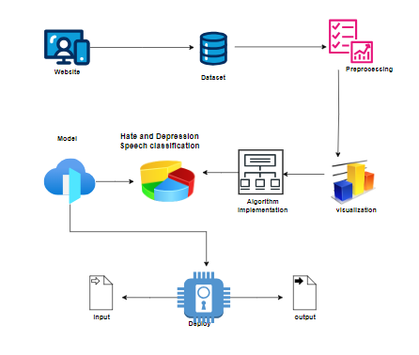
SYSTEM ARCHITECTURE
PREDICTION OF HATE SPEECH AND DEPRESSION CLASSIFICATION

Slide 9
MODULES:
Module 1 - Data Pre-processing
Module 2 - Data Visualization
Module 3 – Decision Tree Classifier Algorithm
Module 4 - Random Forest Algorithm

Slide 10
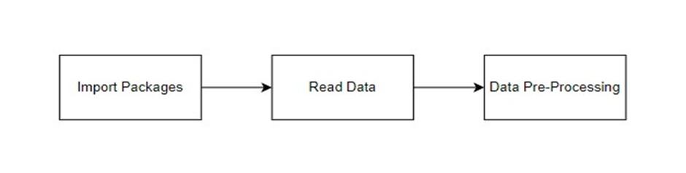
Module 1 Data Pre-Processing:
Import libraries for access and functional purpose and read the given dataset
General Properties of Analyzing the given dataset
Display the given dataset in the form of data frame
Show columns
Shape of the data frame
To describe the data frame
Checking data type and information about dataset
Checking for duplicate data
Checking Missing values of data frame
Checking unique values of data frame
Checking count values of data frame
Rename and drop the given data
To specify the type of values
To create extra columns
GIVEN INPUT EXPECTED OUTPUT
Input: data
Output: removing noisy data

Slide 11
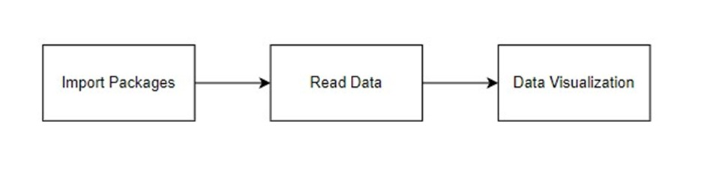
Module 2 – Data Visualization:
Data visualization is an important skill in applied statistics and machine learning. Statistics does indeed focus on quantitative descriptions and estimations of data.
Data visualization provides an important suite of tools for gaining a qualitative understanding.
Sometimes data does not make sense until it can look at in a visual form, such as with charts and plots. Being able to quickly visualize of data samples and others is an important skill both in applied statistics and in applied machine learning.
It will discover the many types of plots that you will need to know when visualizing data in Python and how to use them to better understand your own data.
How to chart time series data with line plots and categorical quantities with bar charts.
How to summarize data distributions with histograms and box plots.
GIVEN INPUT EXPECTED OUTPUT
Input: data
Output: visualized data

Slide 12
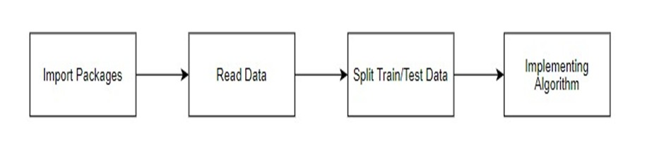
Module 3-Decision Tree Classifier:
Decision Trees are a class of supervised machine learning algorithms used for both classification and regression tasks.
They are versatile and can be applied to various domains, including finance, healthcare, and marketing.
Decision Trees build models by recursively splitting the data based on feature conditions, creating a tree-like structure.
Decision Tree classifier:
1. Decision-Making Process
2. Feature Selection
3. Interpretability
4.Handling Categorical and Numeric Data
5. Overfitting
6. Ensemble Methods
7. Applications
8. Limitations
GIVEN INPUT EXPECTED OUTPUT
Input: data
Output: getting accuracy

Slide 13
Module 4- Random Forest:
Random Forest is an ensemble learning method that leverages multiple decision trees to enhance predictive performance and reduce overfitting.
It is widely used for both classification and regression tasks, offering robustness and improved generalization compared toindividual decision trees.
Random Forest Algorithm:
1. Ensemble Learning
2. Decision Trees in Random Forest
3. Reducing Overfitting
4. Feature Importance
5. High Predictive Accuracy
6. Scalability
7. Applications
8. Hyper-parameter Tuning
9. Limitations
GIVEN INPUT EXPECTED OUTPUT
Input: data
Output: getting accuracy

Slide 14
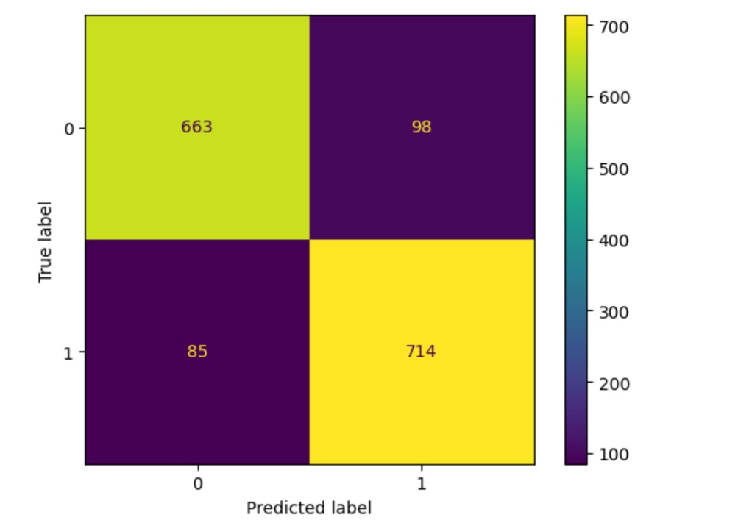
Performance Analysis:
Confusion Matrix For Decision Tree Classifier Algorithm

Slide 15
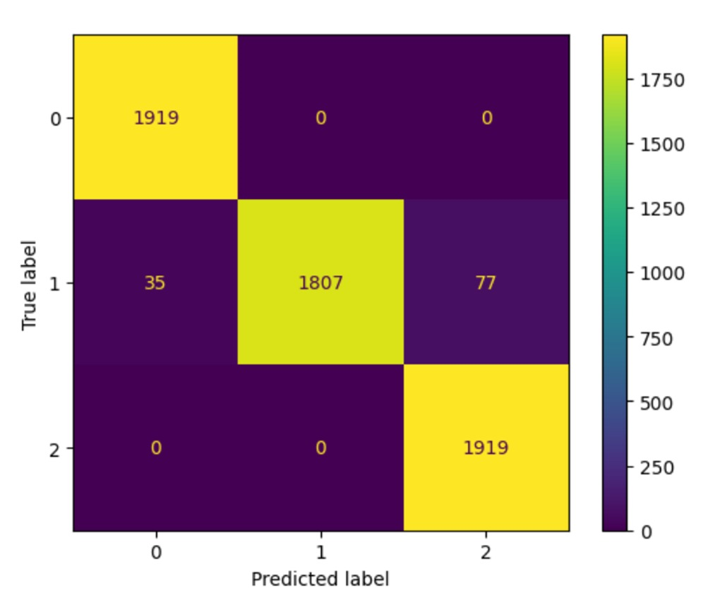
Confusion Matrix For Random Forest Algorithm

Slide 16
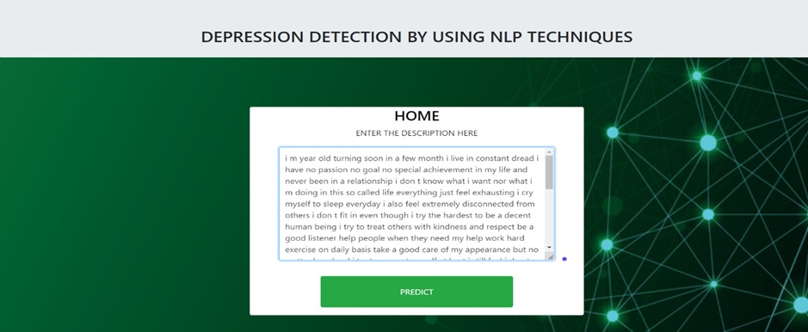
Output:

Slide 17
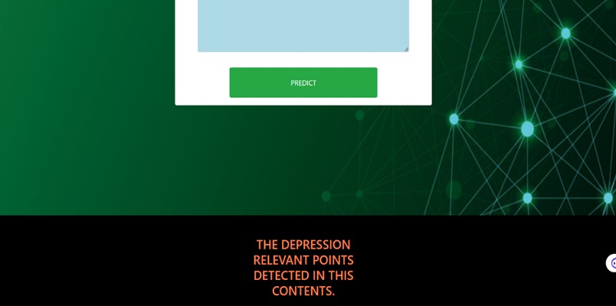

Slide 18
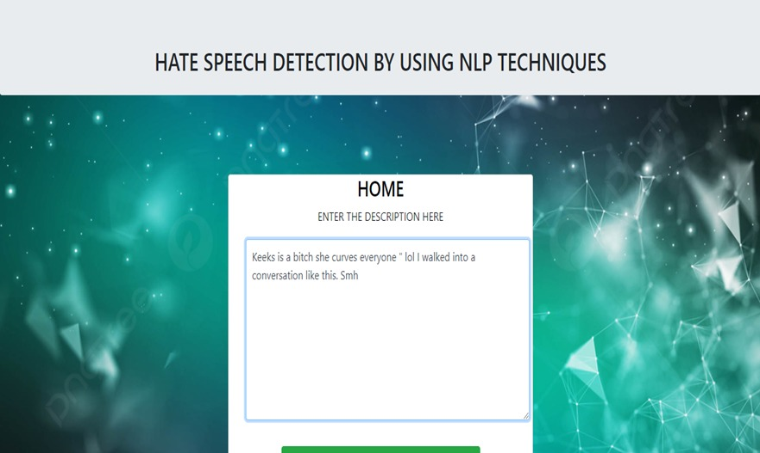

Slide 19
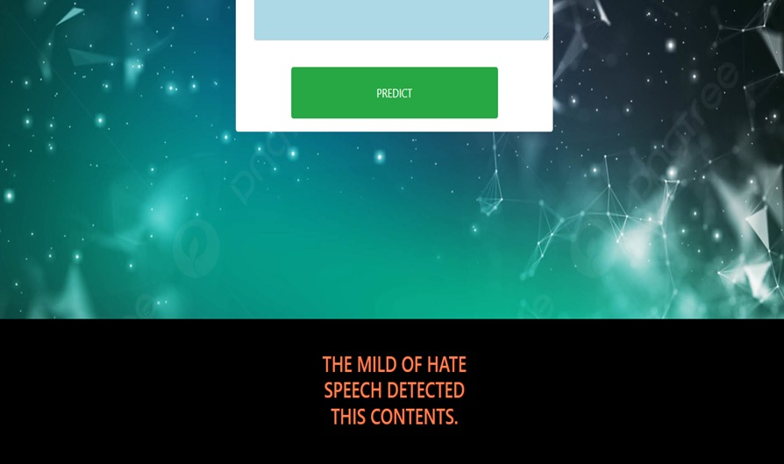

Slide 20
LITERATURE SURVEY :
S.NO. | DATE | AUTHORS | TITLE | METHODOLOGY
1. | 2023 | Sharifa Alghowinem , Tom Gedeon , Senior Member | Interpretation of Depression Detection Models via Feature Selection Methods | Artificial Intelligence
2. | 2021 | Purva Mankar 1, Akshaya Gangurde 2, Deptii Chaudhari | Machine Learning Models for Hate Speech and OffensiveLanguage Identification for Indo-Aryan Language: Hindi | Artificial Intelligence and Machine Learning
3. | 2019 | Yiwen Tang and Nicole Dalzell | Classifying Hate Speech Using a Two-LayerModel | Machine Learning

Slide 21
S.NO. | DATE | AUTHORS | TITLE | METHODOLOGY
4. | 2022 | Olumide Ebenezer Ojo , Thang-Hoang Ta1, Alexander Gelbukh , Hiram Calvo , Grigori Sidorov , Olaronke Oluwayemisi Adebanji | Automatic Hate Speech Detection Using Deep Neural Networks and Word Embedding | Artificial Intelligence
5. | 2023 | Sadari Jayawardena , Member, IEEE, Julien Epps , Member, IEEE, and Eliathamby Ambikairajah , Senior Member, IEEE | : Ordinal Logistic Regression With Partial Proportional Odds for Depression Prediction | Artificial Intelligence and Machine Learning

Slide 22
REFERENCES:
P. H. Soloff et al., “Self-mutilation and suicidal behavior in borderline personality disorder,” J. Pers. Disorders, vol. 8 , no. 4, pp. 257–267, 1994.
World Health Organization, “Depression and other common mental disorders: Global health estimates,” World Health Organization, pp. 7–24, 2017.
A. J. Flint et al., “Abnormal speech articulation, psychomotor retardation, and subcortical dysfunction in major depression,” J. Psychiatric Res., vol. 27, no. 3, pp. 309–319, 1993.
A. Korszun, “Facial pain, depression and stress–Connections and directions,” J. Oral Pathol. Med., vol. 31, no. 10, pp. 615–619, 2002.
A. McPherson and C. R. Martin, “A narrative review of the beck depression inventory (BDI) and implications for its use in an alcohol–Dependent population,” J. Psychiatric Mental Health Nursing, vol. 17, no. , pp. 19–30, 2010.

Slide 23


